Slide 1
The greatest president
Ronald W. Reagan

Slide 2
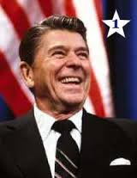
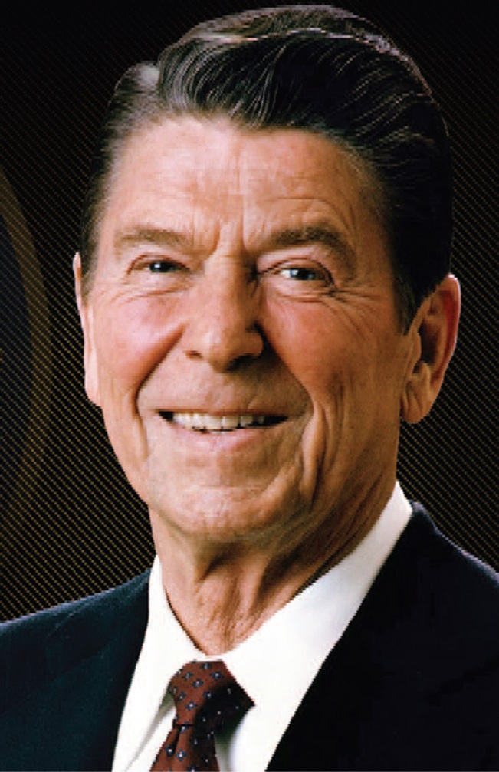

Slide 3
Having peace and strength
“The millitary was distroyed during the carter years, But Reagan turned around and started rebuilding the armed forces”

Slide 4
Money situations
“not only did he cut tax rates but the tax reform act of 1986 simplified the income tax code by getting rid of money shelters.”
“The federal debt was $994 billion when Reagan became president in 1981 it grew to 2.9 trillion by the time his second term ended”

